Slide 1



Current COVID-19 Situation In Canada
Presented By – Yash Shah

Slide 2

Data Analysis Approach
I consult the following information and websites to do this analysis: Ontario Data Catalogue , Government of Canada COVID-19 , Our World in Data
I examined all of the information before creating the report using that information. For easier comprehension, I tried to turn the data into graphs.
I will provide the findings of my analysis in the following slides, and then I will offer some suggestions and thoughts that may assist to prevent issues linked to COVID-19.

Slide 3
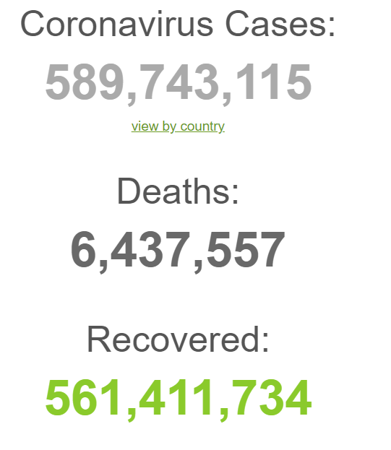
Introduction
Coronavirus disease (COVID-19) is an infectious disease caused by the SARS-CoV-2 virus.
Most people infected with the virus will experience mild to moderate respiratory illness and recover without requiring special treatment. However, some will become seriously ill and require medical attention. Older people and those with underlying medical conditions like cardiovascular disease, diabetes, chronic respiratory disease, or cancer are more likely to develop serious illness. Anyone can get sick with COVID-19 and become seriously ill or die at any age.
The mortality toll due to COVID-19 has surpassed 6M as seen in the image as of right now.

Slide 4
Is Covid-19 Pandemic Over? (According to WHO)
Tedros Adhanom Ghebreyesus delivered his message during the opening of the annual World Health Assembly - the decision-making body of WHO comprised of representatives of 194 countries.
According to him, the Covid-19 pandemic is still ongoing.
Despite the fact that many governments have removed all restrictions and life is now largely as it was before the epidemic, he said, recorded cases are rising in nearly 70 nations across all continents. Tedros warned that reported deaths are also rising.
“This virus has surprised us at every turn – a storm that has torn through communities again and again, and we still can’t predict its path, or its intensity”, he emphasized.

Slide 5
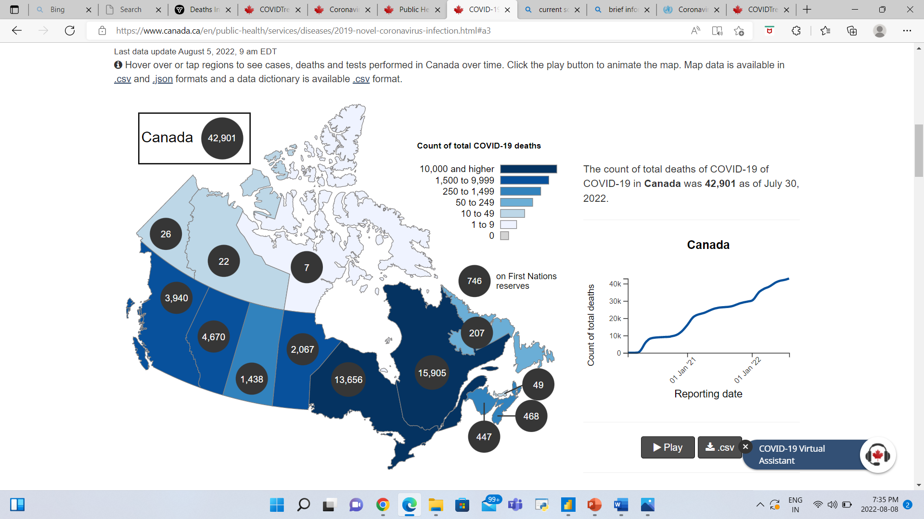
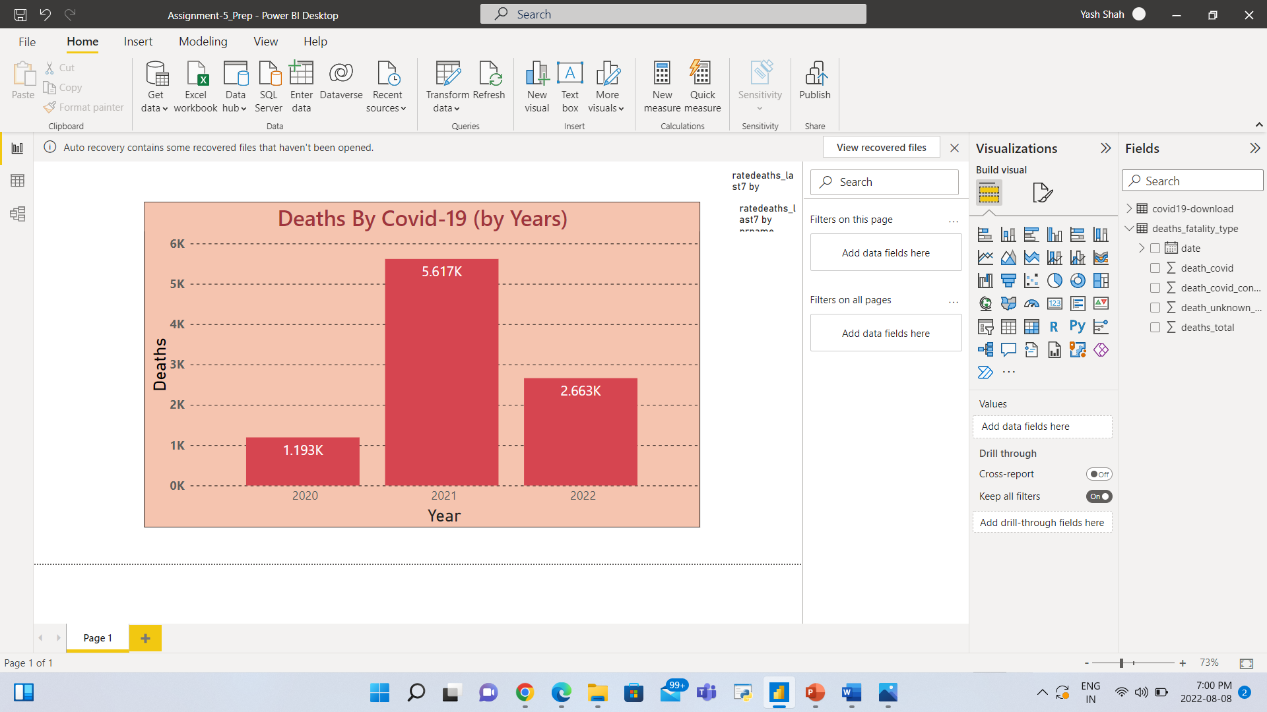
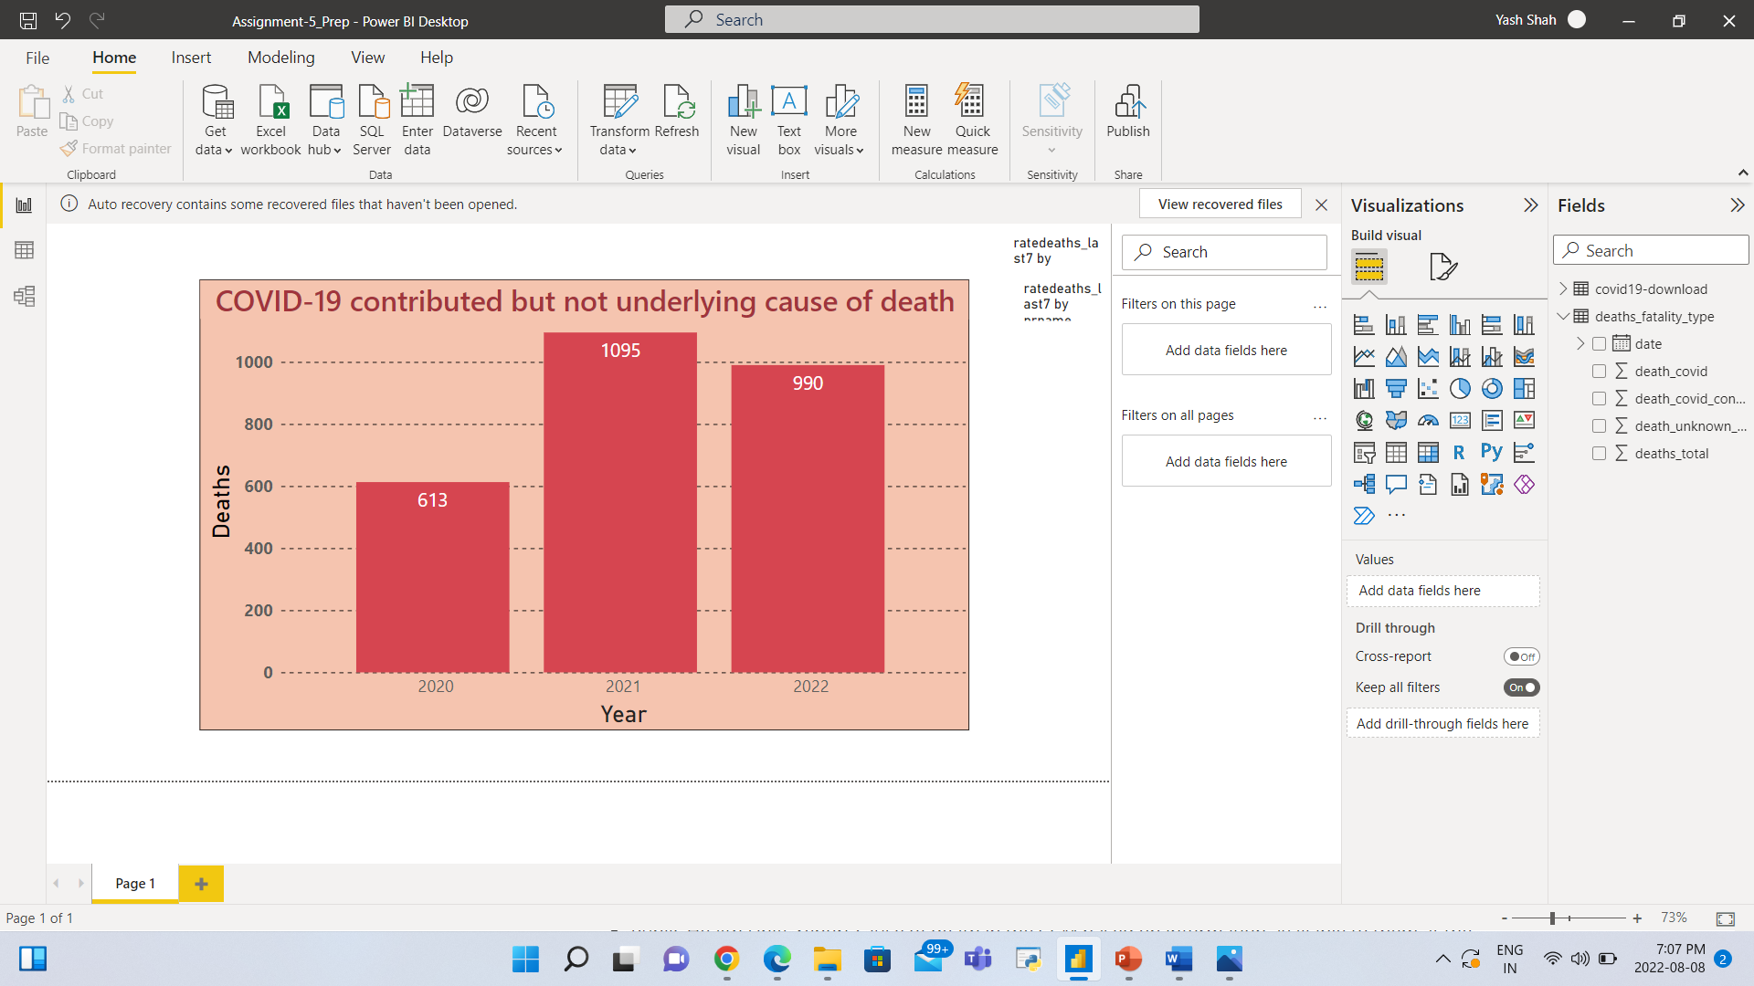
Deaths By Covid-19 (Canada & Ontario)
Ontario

Slide 6
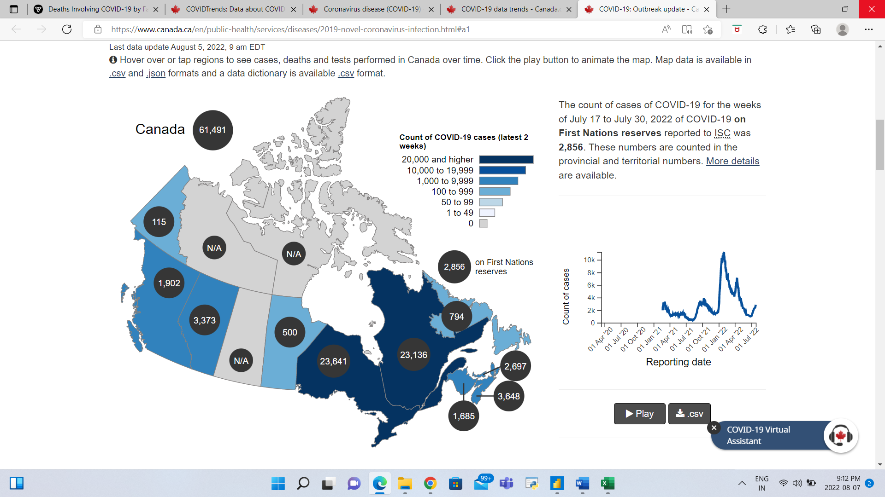
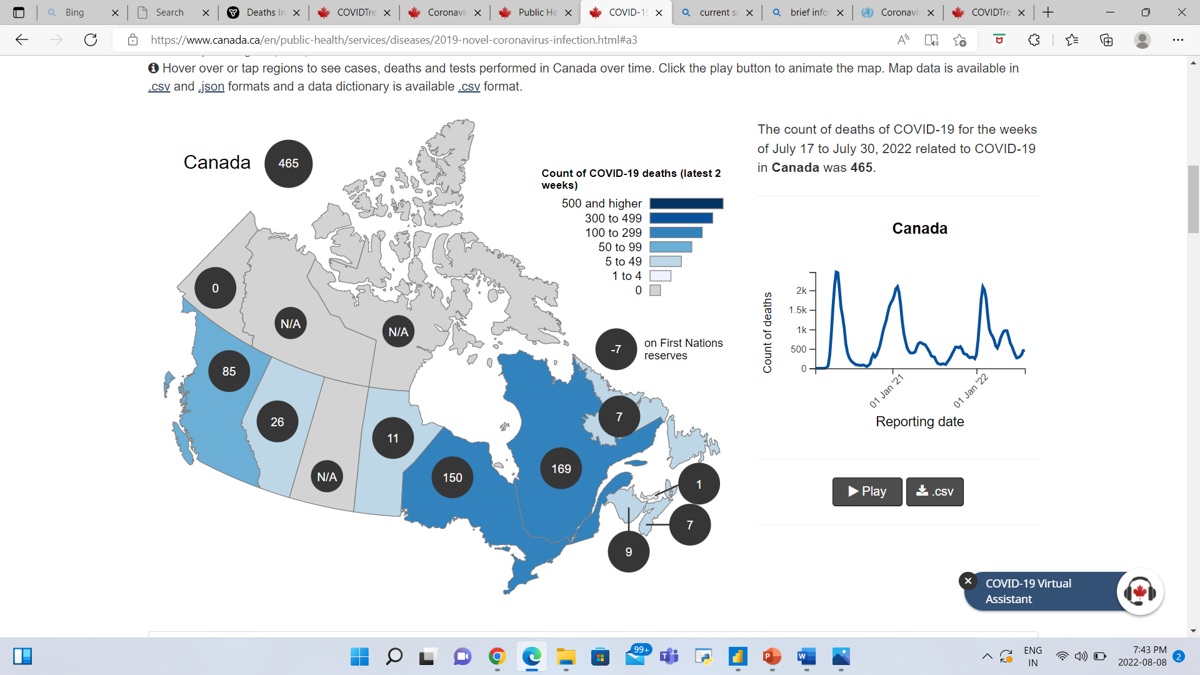
Count of COVID-19 cases (latest 2 weeks)
Count of COVID-19 deaths (latest 2 weeks)

Slide 7
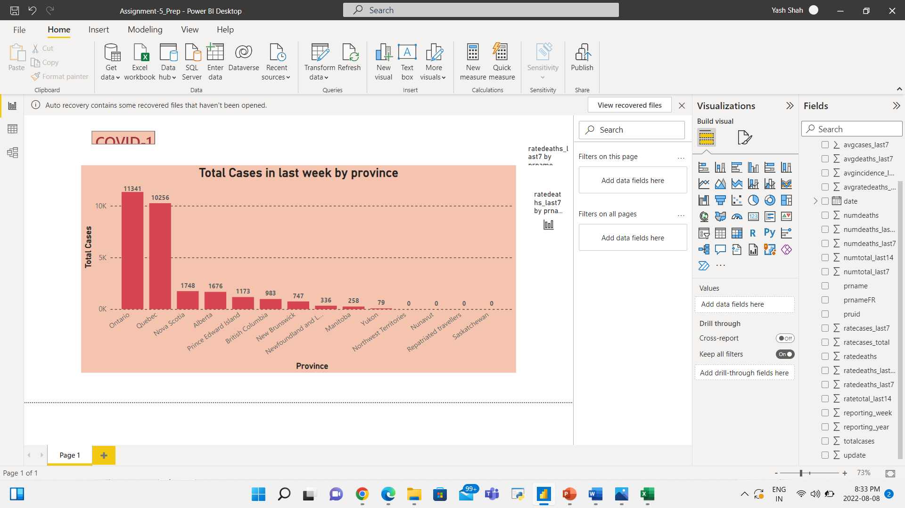

Covid-19 cases and deaths in last week

Slide 8
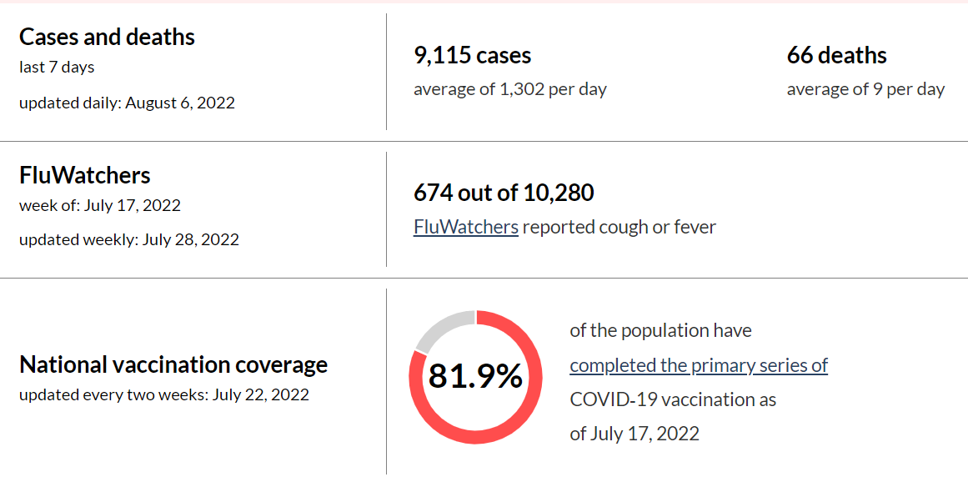
Covid-19 trends of last week

Slide 9


Recommendations
The government should maintain requiring mask use since it was a crucial precaution in the past for preventing the Covid-19.
Wherever it is practicable, the government should foster and promote the culture of working from home and distant learning.
For overseas passengers, the government should implement stringent quarantine regulations.
The government should organize vaccination drives and actively encourage immunization.

Slide 10
References
https://www.canada.ca/en/department-finance/economic-response-plan/completed-measures-respond-covid-19.html
Deaths Involving COVID-19 by Fatality Type - Datasets - Ontario Data Catalogue
COVID-19 epidemiology update - Canada.ca
Coronavirus disease (COVID-19) - Canada.ca
COVID-19: Outbreak update - Canada.ca
COVIDTrends: Data about COVID‑19 in your area | Public Health Agency of Canada

Slide 11
Thank You

